Slide 1


HELLOO LADIESS !!

Slide 2
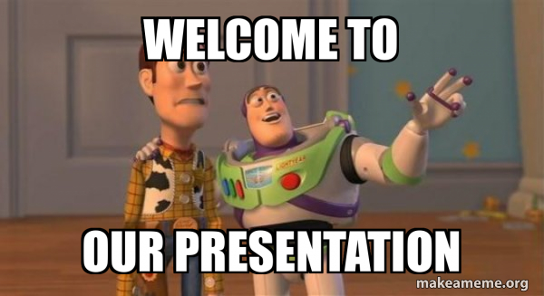

Slide 3
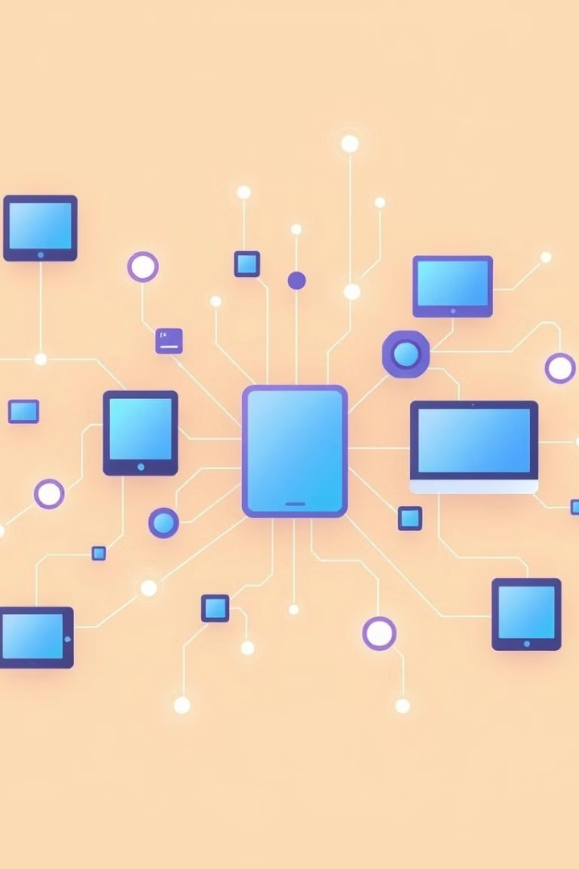
Internet of Things: Simplifying the Connected World
This presentation explores the Internet of Things, its potential, challenges, and real-world applications.
PREPARED BY
Aman Jha, Dipeen Dahal, Gaurav Rouniyar

Slide 4


Abstract: Exploring the Fundamentals of IoT
Connecting Everything
Data Driven Insights
IoT refers to the network of physical objects that are embedded with sensors, software, and other technologies to collect and exchange data.
These devices communicate with each other and with the internet, enabling real-time data collection and analysis.

Slide 5
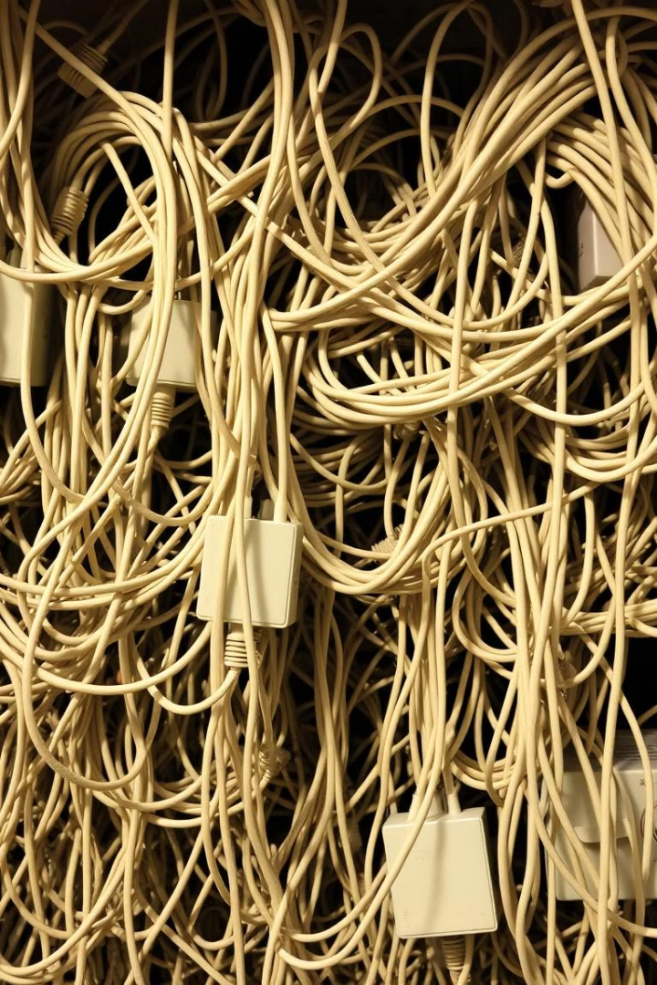
Problem Statement: Addressing the Complexities of Modern Connectivity
Interoperability
Security Risks
The vast array of devices and protocols creates a complex challenge for interaction and seamless data exchange.
The increasing number of connected devices raises concerns about security vulnerabilities and potential data breaches.
Data Privacy Concerns
Concerns around data privacy and ethical considerations regarding the collection and use of personal information.

Slide 6



Research and Findings: Unveiling the Potential of IoT
Efficiency Gains
1
IoT enables greater efficiency in resource management, operational processes, and decision-making.
Enhanced Customer Experiences
2
Improved user experiences through personalized services, real-time information, and seamless interactions.
New Business Opportunities
3
Creation of novel business models and revenue streams based on data-driven insights and connected services.

Slide 7
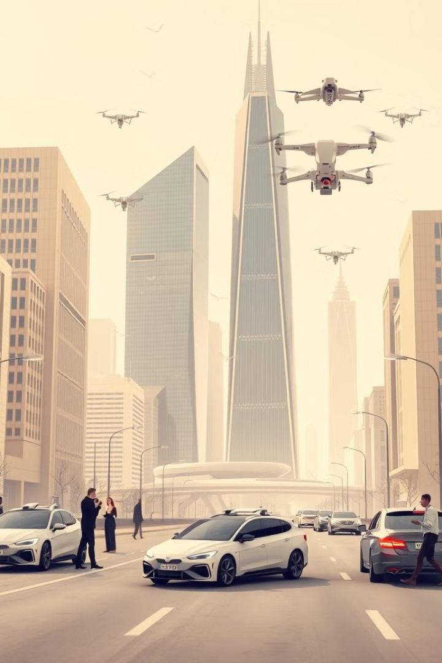




Opportunities: Unlocking New Possibilities with IoT
Healthcare
Agriculture
Remote patient monitoring, personalized treatment plans, and improved healthcare outcomes.
Precision farming, optimized resource utilization, and increased crop yields.
Smart Homes
Manufacturing
Automated home management, energy efficiency, and enhanced security systems.
Predictive maintenance, optimized production processes, and real-time supply chain visibility.

Slide 8
Challenges: Navigating the Barriers to IoT Adoption
Cost
1
The initial cost of implementing IoT solutions can be a significant barrier for businesses.
Complexity
2
Setting up and maintaining IoT systems can be complex and require specialized skills.
Security
3
Security vulnerabilities remain a major concern, requiring robust measures to protect data and devices.
Privacy
4
Balancing the benefits of IoT with concerns about data privacy and ethical use is crucial.

Slide 9

Real-World Applications: Showcasing IoT in Action
1
Smart Cities
Traffic management, environmental monitoring, and efficient resource allocation.
2
Smart Homes
Automated lighting, temperature control, and security systems.
3
Connected Cars
Remote diagnostics, driver assistance features, and autonomous driving technologies.

Slide 10

Conclusion: The Future of a Connected World
The Internet of Things is rapidly transforming our world, offering new possibilities for efficiency, innovation, and connectivity. As the technology matures, it is likely to have a profound impact on various industries, shaping the future of our society.

Slide 11


Slide 12
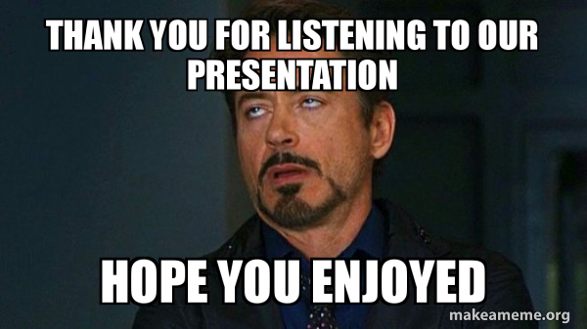

Slide 13
